Slide 1


Raven - Android SMS Translator
Vladimir Novikov 312669112
Eran Naor 300511987

Slide 2
Summary
Raven is an Android application that automatically recognize foreign language written in your income SMS messages and immediately connects to the internet and suggest you the best translation directly to your native language

Slide 3
Features
Translations of a variety of languages
Automatically locates your native language from the machine GPS coordinates
User defined words
Vibrate and modified rings alerts from notifictions
Remembers contacts language

Slide 4
Requirements
# | Requirement | Description
1 | Min Android SDK Version | 11
2 | GPS | Suggest locale language for the user
3 | Internet Connection | The translation works online
4 | SMS | The application translate only incoming\outgoing SMS’s

Slide 5
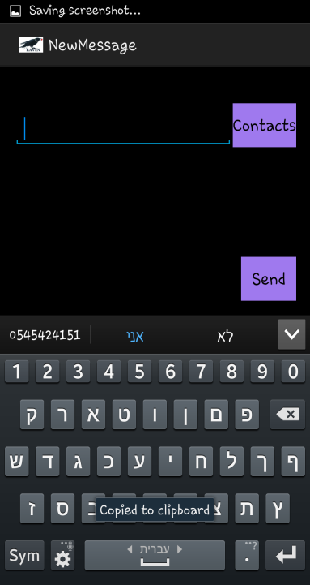
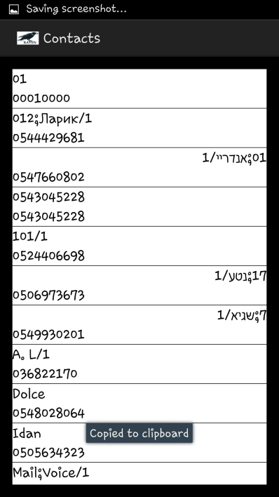
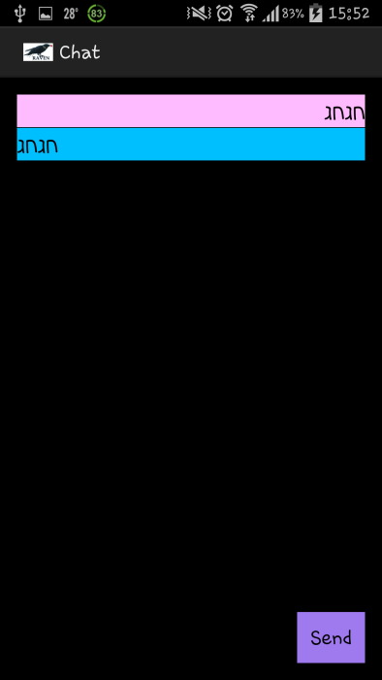
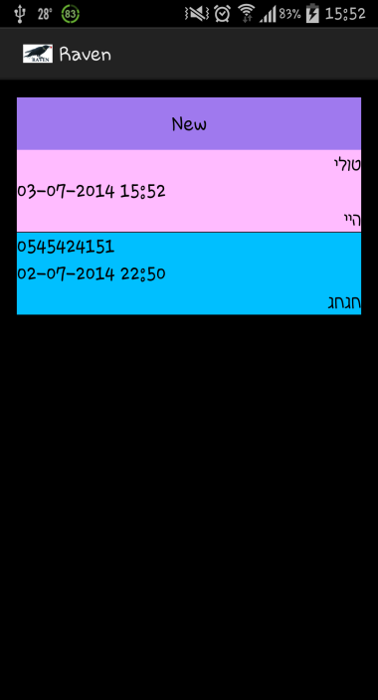
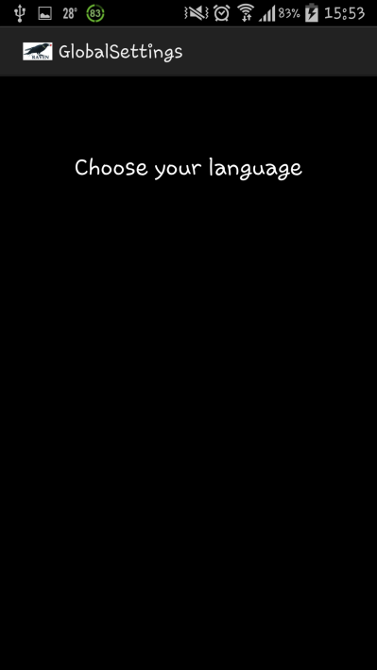
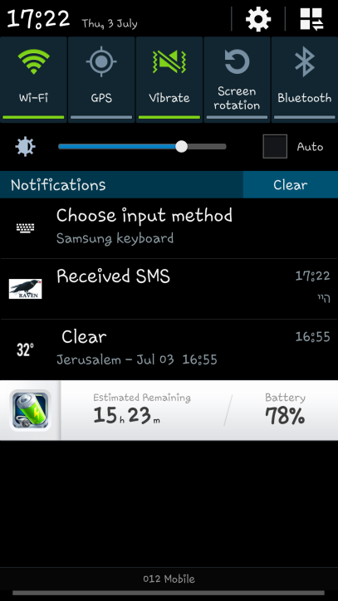
Screens

Slide 6
Data Base Design
Contacts
translate | language | type | phone | name | id
integer | string | string | string | string | integer
Messages
time | sent | read | Received or sent | Translated txt | txt | phone | Id
string | integer | integer | integer | string | string | string | integer
Flags
value | key
integer | string

Slide 7
Application Design
Chat Activity
(represent the chat with contact)
Contacts Activity
(to show all the contacts in the phone)
RavenDB
(sql queries)
User Settings Activity
(to choose the language to translate for specific contact)
RavenDAL
(DB handler)
History Activity
(show all the last messages from all contacts)
SMSReceiver
(Broadcast Receiver to receive the sms)
New Message Activity
(write a new message to chosen contact)
Global Settings Activity
(choose your own language)
ContactObserverService
(Singleton Service on another proccess to update contacts list)

Slide 8
Translator Design
Translator
(Factory Method)
Bing
Google
Yandex
MyMemory
Raven
(Translator Selector)

Slide 9
Usage
SmsManager
HTTP calls
REST API
Provider
Services
GPS
Sqlite
Asynchronies tasks

Slide 10
Tests
Contact list update as a service tested manually with updating a contact and confirming that update has occurred.
Sms receiver and sms sender tested with sending and receiving sms.
Translation tested with a call to the translating services with some text and a chosen language.

Slide 11
Working example demonstration

Slide 12
Farther development
Inegration interface with translator
Implement more translators API providers
Pull data text from multiple translate services and get the best result
Remember user defined words
Import all SMS messages to the app
Save conversation to SD card
OCR
Upload to google play – 3.90$

Slide 13
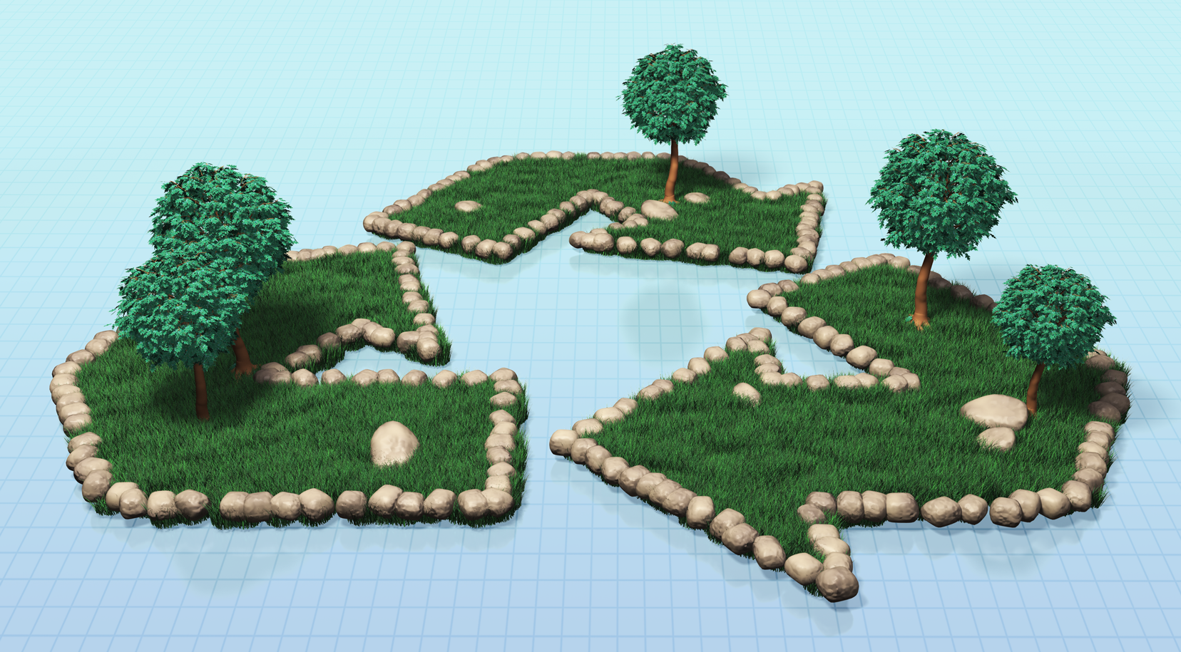

Questions???

